Slide 1



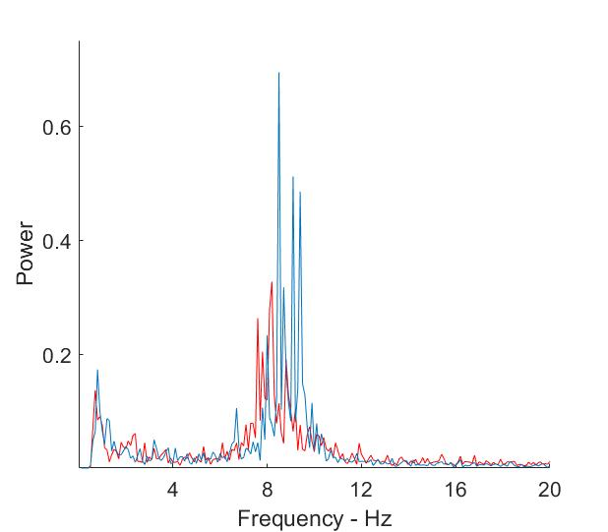
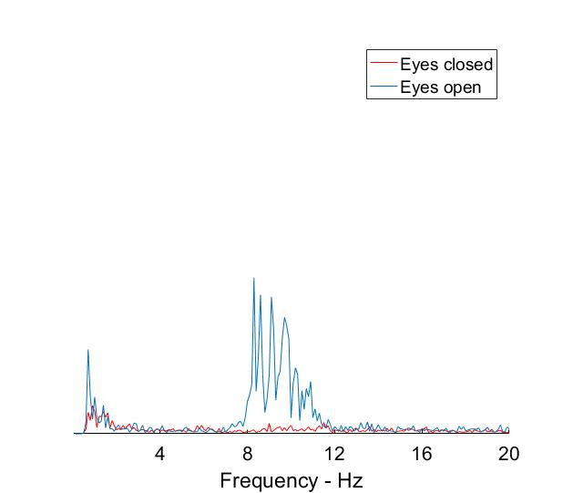

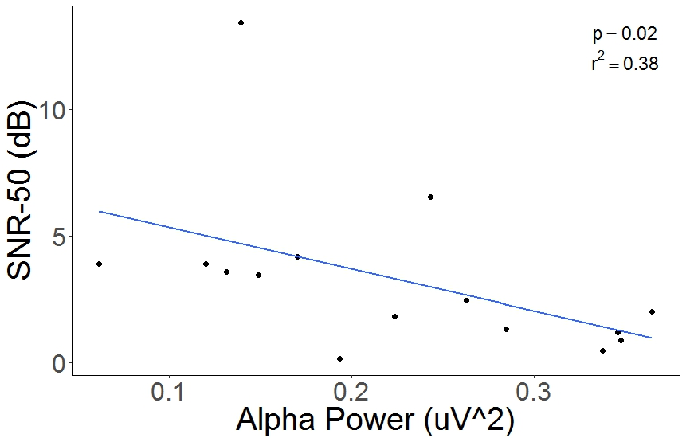
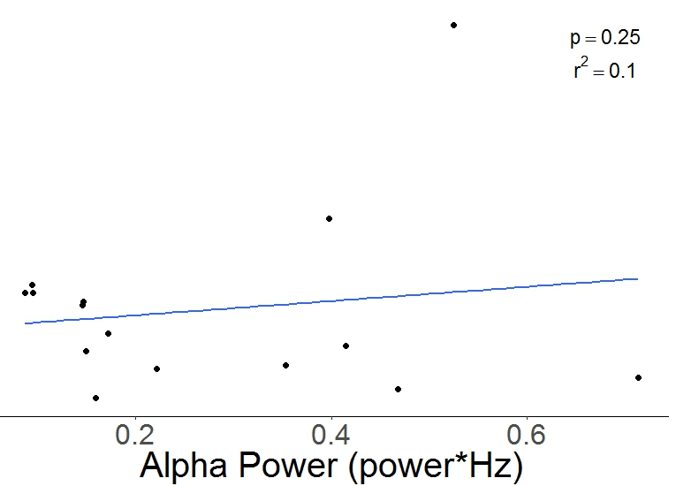
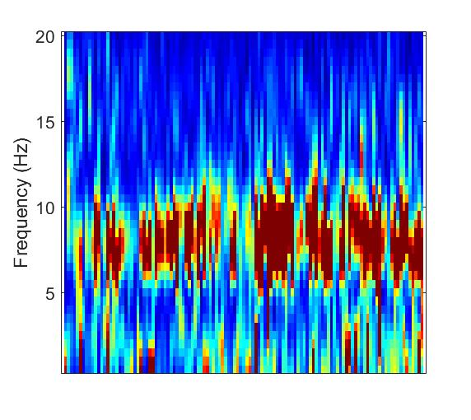
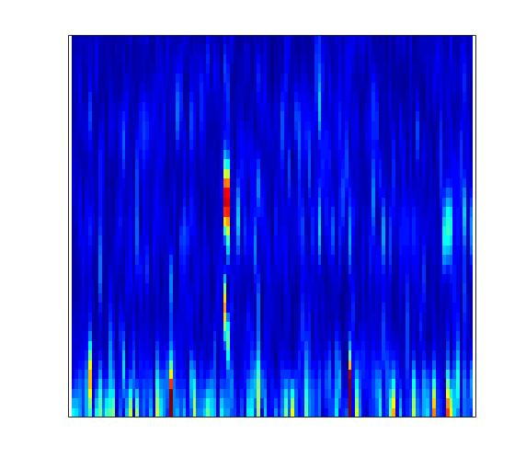
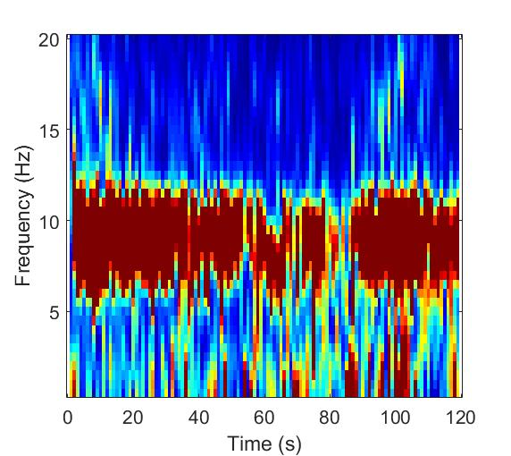
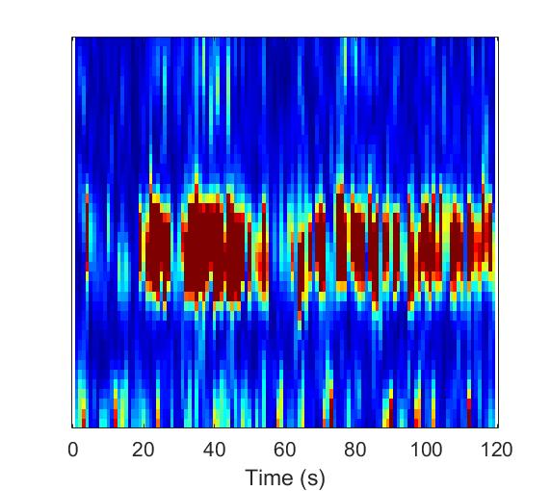
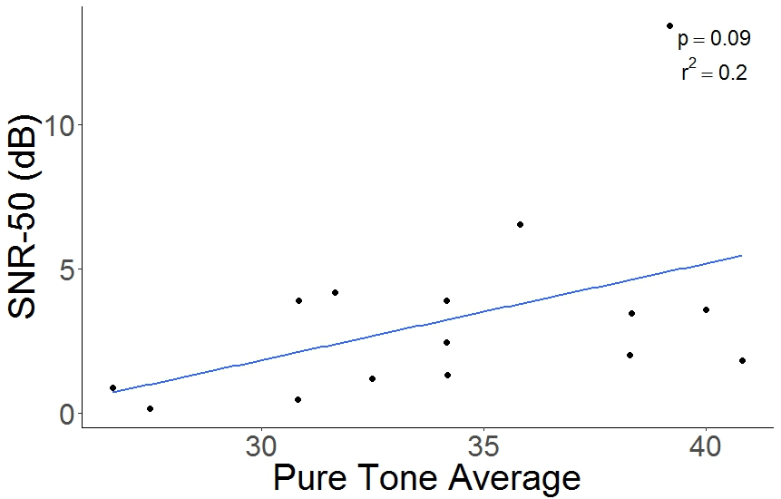
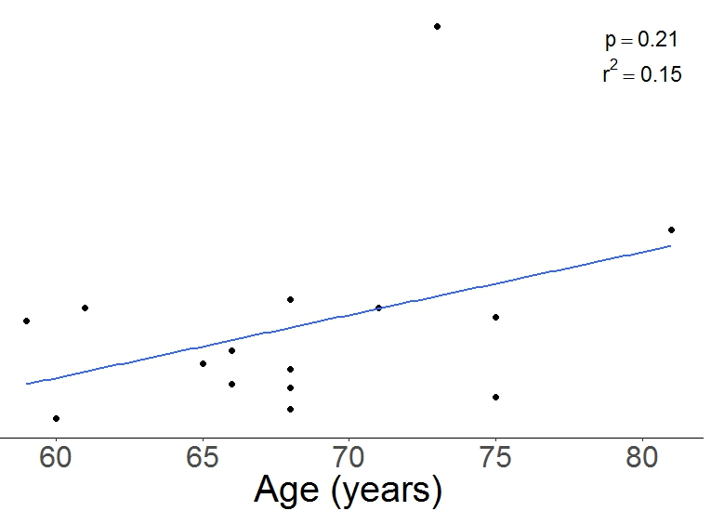

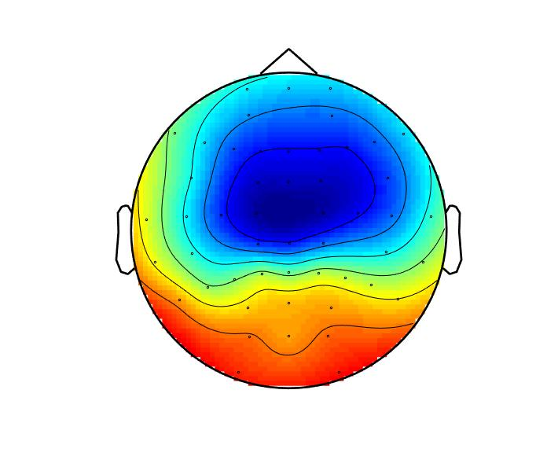
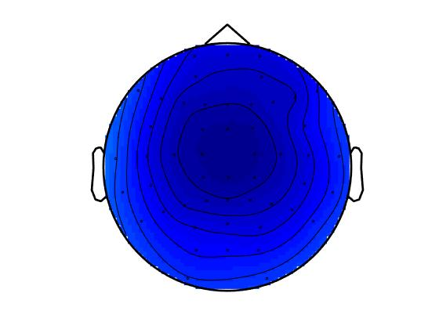
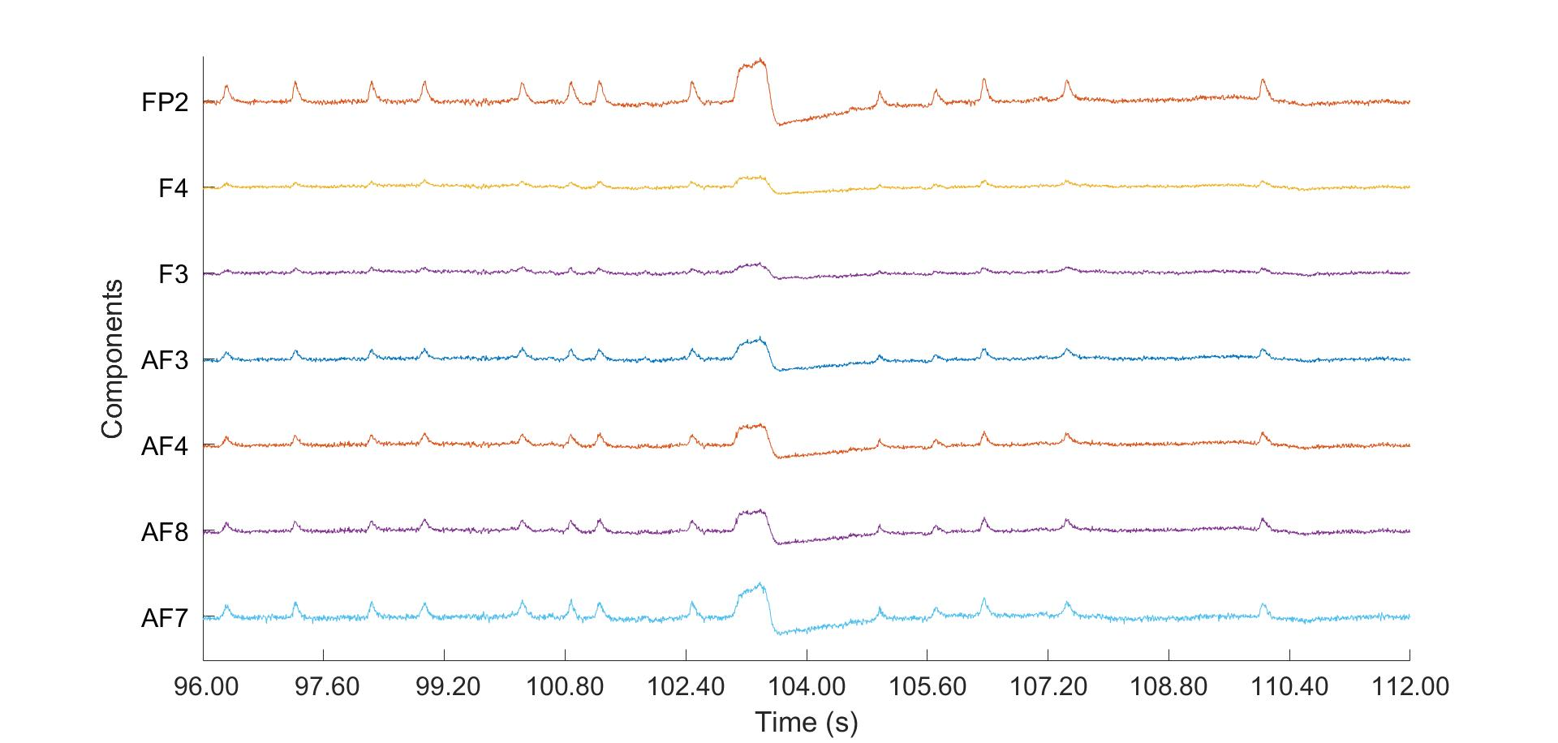
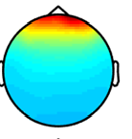
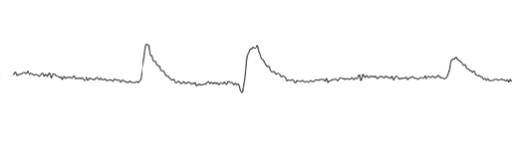
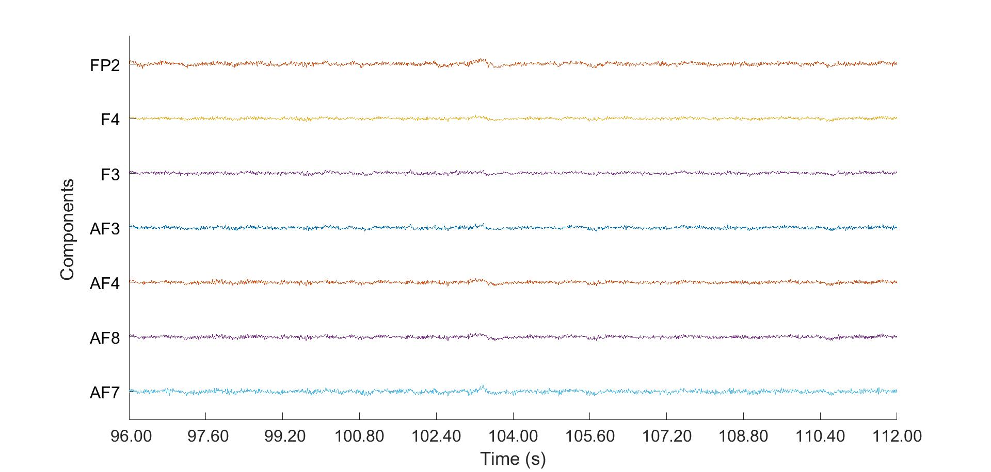
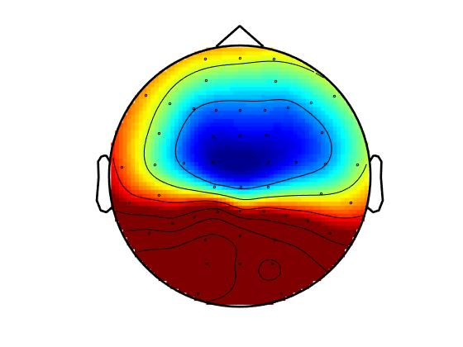
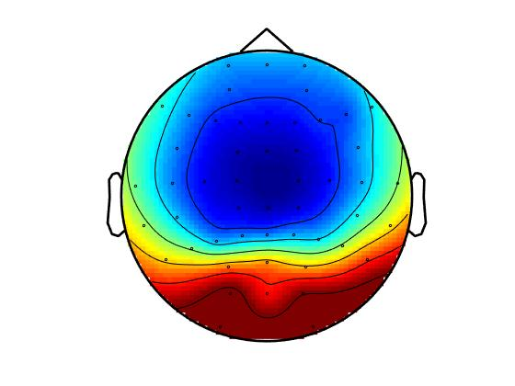
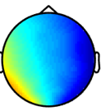
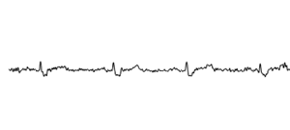
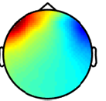
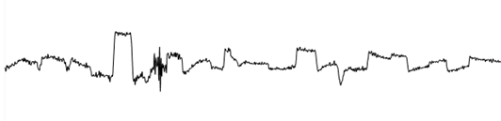
Variations in speech-in-noise thresholds as it relates to central inhibitory function
Michael L. Smith¹, Michael L. Lee¹, Christi W. Miller¹, Yu-Hsiang Wu², Ruth A. Bentler², & Kelly L. Tremblay¹
1. Department of Speech & Hearing Sciences, University of Washington, Seattle, WA USA
2. Department of Communication Sciences & Disorders, University of Iowa, Iowa City, IA USA
1. Introduction
3. Results
3. Results Continued
objectives
Speech understanding in the presence of background noise is a major issue for individuals with hearing impairment
Aging, in addition to hearing loss, affects central inhibitory function¹, and could potentially contribute to poor speech in noise (SiN) performance
Cortical alpha (7.5-12.5Hz) activity is an indirect measure of central inhibition and is believed to contribute to a person’s ability to understand SiN^{4,6,7}
The relationship between Alpha rhythms and SiN perception have been studied^{6,7}, and resting state or reference alpha power activation has been positively associated with performance in other cognitive tasks^{2,5,8}
Less is known about how individual resting state alpha relates to SiN performance
Increased alpha activity is believed to aid in the suppression of background noise, thus allowing the listener to focus on the relevant signal (speech)⁷
Purpose of the present study was to examine if an individual’s inhibitory function, as defined by their resting state alpha activity, would contribute to signal-to-noise ratio (SNR) thresholds
Resting state alpha activity varied among subjects
SNR thresholds significantly associate with alpha power
High alpha subject
Low alpha subject
 | Est. co-efficient | Standard error | P-value
Alpha power eyes open | -30.6 | 8.4 | 0.003*
Alpha power eyes closed | 11.8 | 4.2 | 0.02*
Table 1. Linear regression model (y=β₀+ β₁X₁+ β₂X₂) where y=SNR-50 threshold, X₁=alpha power eyes open, X₂=alpha power eyes closed, and β₀ the y intercept. Significance is indicated by *
2. Methods
Decreased SNR thresholds were associated with increased alpha power
Participants: Adult bilateral hearing aid users (n = 15), age 59-81 (mean = 68.3)
Mild-moderate hearing loss
All subjects wore hearing aids for at least two years prior to testing
All testing was performed unaided
Baseline resting state activity was recorded in a silent, dark environment
EEG Recording
64 channel Neuroscan system
Online sampling rate of 1000Hz
Alternating 2 minute blocks with eyes open/eyes closed
Three blocks per condition
SiN Testing
Speech: presented in sound field, single speaker 0° azimuth, 1m away
Noise: 4-talker babble in foreign languages (ISTS)³
English sentences presented at -10 to +15 SNR in 5dB steps
SNR-50 thresholds were estimated by fitting a psychometric function to correct or incorrect responses on the Hearing in Noise Test (HINT)
SNR-50 is the dB threshold where an individual answers 50% of the words correctly
Noise held constant at 65dB SPL while sentences varied adaptively in 5dB steps
Data Analysis Pipeline
Alpha power was calculated using Fieldtrip, a MATLAB based toolbox
Trials were defined as eyes open or eyes closed
Bandpass filtered 0.5-50Hz
Down sampled to 250Hz
Independent Component Analysis (ICA) was used to remove biological artifacts such as eye blinks, eye movements, and electrocardiogram (EKG; Fig.1), as well as noisy channels (i.e. 60Hz)
ICA was conducted over the continuous EEG recording
Average of 3-5 components removed per subject
Figure 2. Fast Fourier Transform (FFT) for two subjects across occipital channels OZ,O1,O2,POZ,PO3,PO4 in both the eyes open and eyes closed condition.
Eyes Open
Eyes Closed
background
Time frequency data averaged across occipital channels: OZ,O1,O2,POZ,PO3,PO4
Figure 5. Significant associations between SNR thresholds and alpha power during the eyes open condition were observed (p = 0.02). Eyes closed alpha power did not significantly effect SNR-50 thresholds (p=0.25). Alpha power was calculated as area under the curve from the FFT power spectrum in the alpha frequency band (7.5-12.5Hz). All correlations used the Spearman method.
Figure 3. Time frequency data for two subjects. The top row of panels shows oscillatory activation in the eyes open condition, and the bottom row eyes closed, for each subject respectively. Oscillatory activity is shown with the greatest activation in the alpha band (7.5-12.5Hz).
Figure 6. SNR-50 thresholds as a function of pure tone average (PTA) and age, respectively. Neither PTA or age was significant (p=0.09,p=0.21) in how they affected SNR-50 thresholds. All correlations used the Spearman method.
Topographical representation of alpha band power
4. Conclusions
Eyes Open
A. Raw EEG Signal
B. ICA Components Removed
C. Clean EEG Data
Individual subject alpha power differences were observed in both conditions
Alpha power was primarily concentrated to occipital areas
Alpha power was greater in the eyes closed condition compared to eyes open
SNR-50 thresholds decreased as a function of alpha power during the eyes open condition, and increased during eyes closed
Audibility and age did not significantly contribute to SNR-50 thresholds
EEG alpha power may be predictive of SNR-50 threshold outcome measures
Subject 1
Eyes Closed
Subject 2
References & Funding
Figure 1. ICA artifact removal pipeline. A) Select channels showing raw EEG data bandpass filtered 0.5-50Hz. Note the eye blink artifacts across channels, and a large eye movement at ~103 seconds. B) Topo-maps of three independent components (ICs) and their distinct waveforms: eye blinks, EKG, and eye movements respectively. C) EEG data after removal of the ICs. Note the contrast to the raw waveform.
Figure 4. Oscillatory alpha band activity estimated at the level of the scalp. Top row of panels represents two subjects during the eyes open condition, and with eyes closed in the bottom row. Notice the subject differences in the eyes open condition, and the similarities during eyes closed. Greater differences in the eyes open condition would suggest subject 1 has higher resting state alpha power compared to subject 2, which may lead to performance differences in SNR testing (data not shown).
Billings, C. J., Tremblay, K. L., & Willott, J. (2012). “The aging auditory system,” in Translational Perspectives in Auditory Neuroscience: Hearing Across the Lifespan. Assessment and Disorders, K. Tremblay and R. Burkard, Eds. Plural Publishing, Inc, San Diego, Calif, USA
Doppelmayr, M., Klimesch, W., Stadler, W., Pöllhuber, D., & Heine, C. (2002). EEG alpha power and intelligence. Intelligence, 30, 289–302.
Holube I., Fredelake S., Vlaming M. & Kollmeier B. 2010. Development and analysis of an International Speech Test Signal (ISTS). International Journal of Audiology, 20, 891–903.
Jensen, O., & Mazaheri, A. (2010). Shaping Functional Architecture by Oscillatory Alpha Activity: Gating by Inhibition. Frontiers in Human Neuroscience, 4, 186.
Klimesch, W., Vogt, F., & Doppelmayr, M. (1999). Interindividual differences in alpha and theta power reflect memory performance. Intelligence, 27(4), 347–362.
Petersen, E. B., Wöstmann, M., Obleser, J., Stenfelt, S., & Lunner, T. (2015). Hearing loss impacts neural alpha oscillations under adverse listening conditions. Frontiers in Psychology, 6, 177.
Strauβ, A., Wöstmann,M., & Obleser, J. (2014). Cortical alpha oscillations as a tool for auditory selective inhibition. Frontiers in Human Neuroscience, 8, 350.
Vogt, F., Klimesch, W., & Doppelmayr, M. (1998). High-frequency components in the alpha band and memory performance. Journal of Clinical Neurophysiology, 15(2), 167–72.
Funding provided by NIDCD 5R01DC012769-05

